Slide 1
Sprint 2
Jordy Walraven

Slide 2
Sprint goals
Setup walking skeleton
Create C4 diagram (Level 1 and 2)
As a software architect, I want to determine the most suitable architectural styles for my system's requirements so that I can design an effective and scalable solution.
As a PC-gamer I want to create an account, so that I can add and view account specific data
As a developer, I need to understand how various services or components within the system communicate with each other, so that I can ensure seamless interaction and integration between different parts of the system.
Setup CI/CD

Slide 3
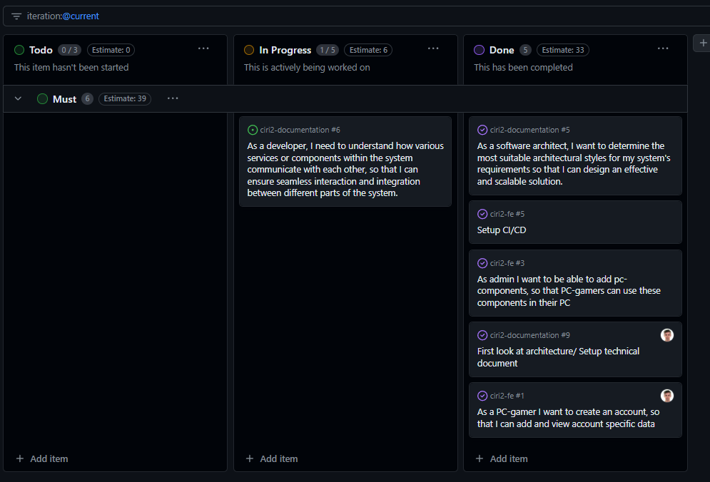
Sprint achievements

Slide 4
Relevant updated documentation
Analysis Document
Research Report
Technical documentation

Slide 5
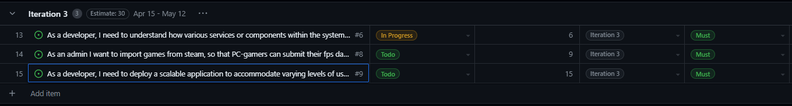
Sprint planning
https://github.com/orgs/CIRI2-s6/projects/2/views/2

